Slide 1
Career Skills 101
Session 8

Slide 2
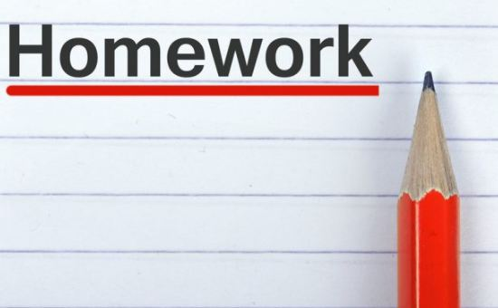
Homework
Give someone feedback and be prepared to tell the group about it
Be punctual
Pay attention to the quality of your work – do your best
Practice your elevator speech.

Slide 3
Ice Breaker
Notes:
Ice Breaker Lego mania
Divide into 2 groups. Pre-build a small Lego structure and place on a table. Not to complicated. Each team must replicate the structure exactly including size and color, in 10 minutes. Only one member from each group (architect) may look at the original structure. The architect must figure out how to communicate size, color and shape of the original structure to their team. The architect viewing the structure must not touch the new structure his/her team is building. Build the structure as close as possible to the sample.
Discuss teamwork, communication, leadership and initiative.
What worked well and what did not work very well.
THINK CRITICALLY / ASK QUESTIONS / MAKE A PLAN

Slide 4
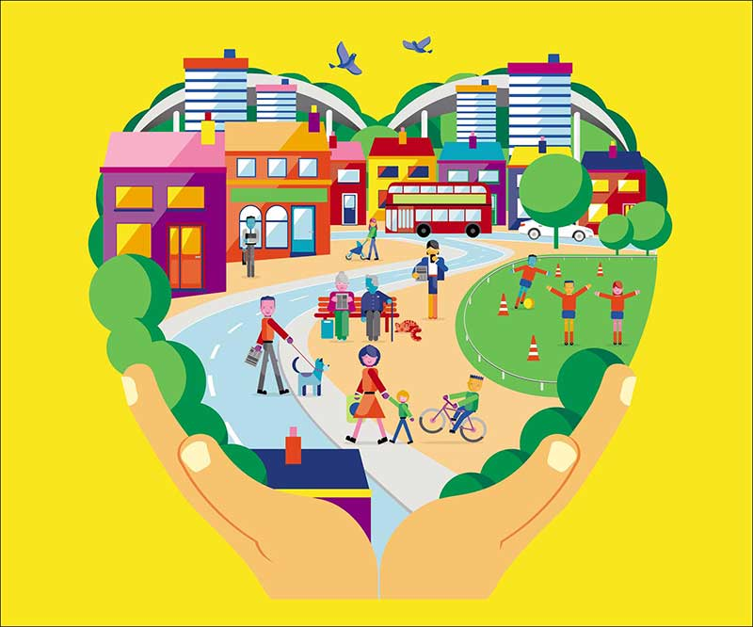
Community
Notes:
Social Capital – See workbook
Being connected to community starts with examining your personal connections.
Who are your family and friend connections?
Who are your paid supports?
Who are your community connections?
Being connected to your community is essential to finding new jobs and having new opportunities. People you know are connected to other people.
Those people can connect you.

Slide 5
Complete community connections
ME
neighbors
business people
church
family
Teachers
Notes:
Trainer – on a flipchart complete a community connections map for yourself. List names of people in each circle and make branches off if it to include other you have met.
Ask each person to complete a community connection map for themselves.
When they are done ask people:
How many people met friends at church?
How many met friends at sports or social events?
How many people got a job because they knew someone else?
We never know when we will connect with people again. It is important to develop healthy social connections with people. We may work with them someday or go to church or sports.
Activity – ask each person to tell you something they would like to learn. Put it on a flip chart.
Now read the list and ask people to look at their community connections – who knows someone that could help that person learn?
For example if you had someone that wanted to learn to sew – who in the group know someone that sews?
People in our class are not part of our community connections.

Slide 6
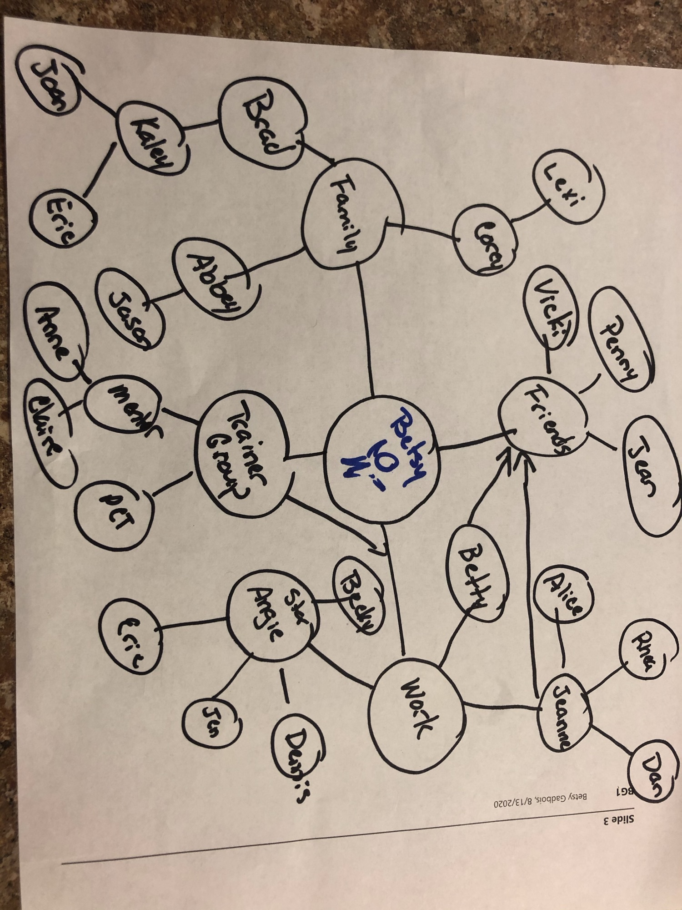

Slide 7
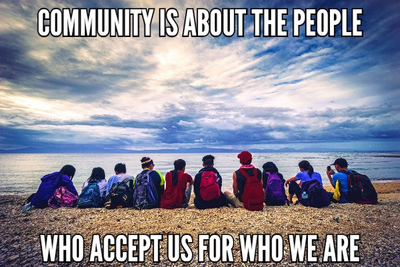
Thought for the Day
Notes:
Each class will have a thought for the day. Share the thought for the day and ask the group what it means to them. Share what it means to you.
You can change the thought for the day if you have one that fits better for you.

Slide 8
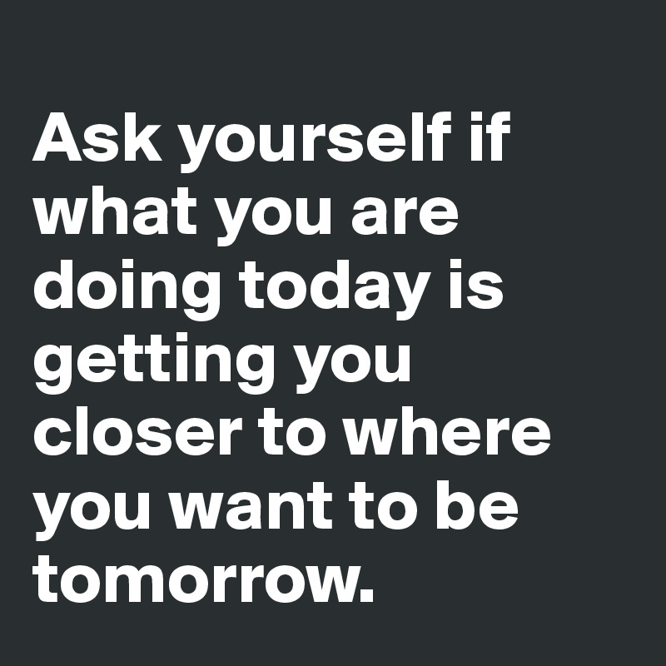
Thought for the Day
Notes:
Each class will have a thought for the day. Share the thought for the day and ask the group what it means to them. Share what it means to you.
You can change the thought for the day if you have one that fits better for you.

Slide 9
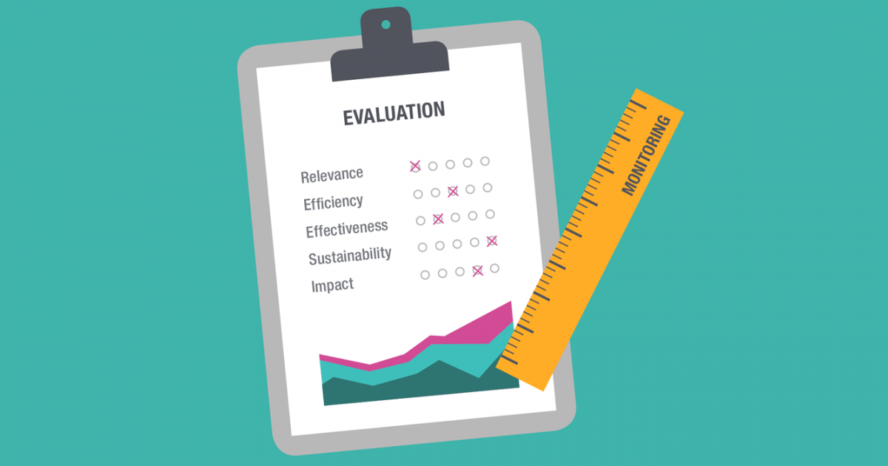
Evaluation
Notes:
Please complete the evaluation with each participant at the end of the session.
This evaluation must be submitted to Jeanne Eglinton at MDI
Jeanne.Eglinton@mdi.org

Slide 10
Virtual Graduation
Notes:
Celebration
Assignments
Greeters – these people wait at the door and walk people to the room where the graduation will happen
Sign in and name tag – these people will greet people as they come in the door and be sure they have a name tag
Hosts – people to invite people to coffee or a cookie
Elevator speech readers
Thank you at the end of the ceremony.
No food or drink at celebration for people in the celebration until after
Reminders
Prepare your clothes for celebration – what will people wear? MDI gave each person a t-shirt to wear the day of. We kept the t-shirt at the organization until the day of to prevent someone from forgetting it.
Be before time – the group should be in class one hour prior to graduation for a walk through.

